Slide 1
Searching for modelling tools for supporting long-term energy transitions
Suggested guidelines for a research plan
ClimTrans²⁰⁵⁰
Stefan Schleicher
Angela Köppl
24 April 2015

Slide 2
The issues
How could our energy system look like in the very-long term (e.g. 2030 or 2050)?
How shall we describe in an analytical framework such an energy system?
How can the transition to a very-long term structure be handled in such an analytical model?
Which research gaps might become visible from the insights obtained from these answers?

Slide 3


Slide 4
Fathoming the future of our energy systems
What we might already know

Slide 5

Buildings
Life Cycle Tower One
Dornbirn, Austria

Slide 6

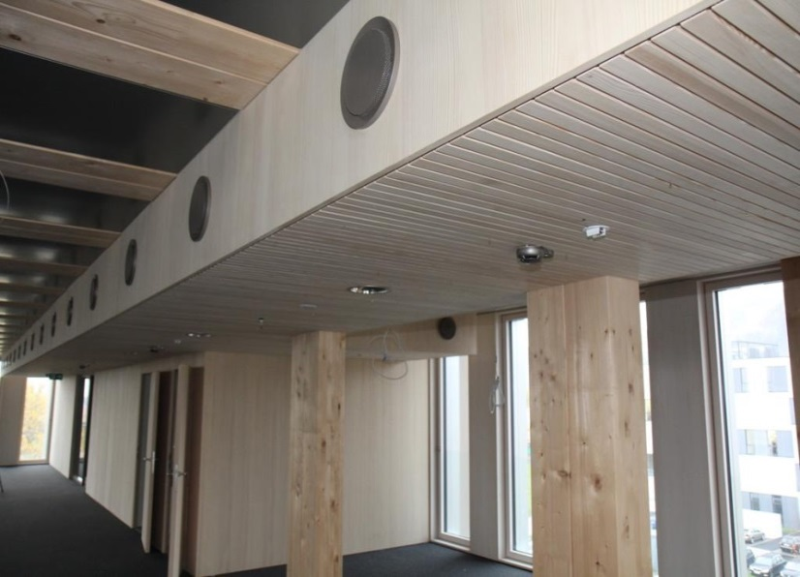
The future of buildings
It is available already now
Wood-hybrid house
  8 floors
Extreme low-energy standard
  1/10 of buildings average
Modular construction
  Prefabricated elements
Life Cycle Tower One
in Dornbirn, Austria

Slide 7


A new mindset for buildings
Their new functionalities
New requirements
  “Working at home”
  Aging society
Buildings will serve as infrastructure for the energy system
  Integrated PV and wind turbines
  High-efficient co-generation of heat and power
2226 House in Lustenau,
Austria

Slide 8


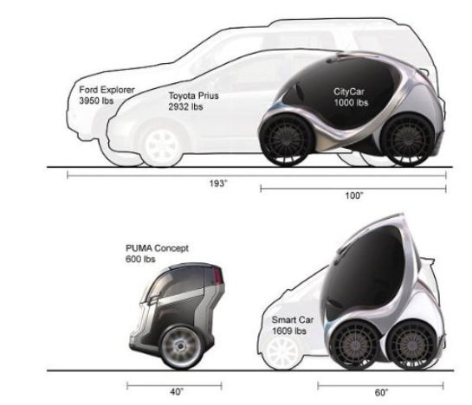
Mobility
What could this mean
in the future?

Slide 9

Mobility does not always need a transport activity
e.g. 3D video conferences
Mobility
means access to persons and commodities
For this functionality we will need much less transport activities
Holographic telepresence

Slide 10
Almost no current modelling approach can adequately deal with long-term transitions
But this is still not an accepted insight

Slide 11
Why the conventional
“black box” approach is insufficient
The energy system is described by a transfer functions between
energy flows and presumed causalities
Poor representation of structure and technologies
Mechanisms, e.g. impact of prices, are mixed with structures

Slide 12
Guideline 1
Make (as much as possible of) the full structure of the
(energy) system visible

Slide 13
The advanced
“structural” approach
Opening the “black box” reveals a cascade structure
This cascade structure is a characteristic feature for energy systems
We need in particular more information about the top layers of the cascade

Slide 14
Guideline 2
Separate the representation of the structure from the representation of mechanisms

Slide 15
Structures can be driven by a variety of mechanisms
Applying different mechanisms should not require different representations of the structure
Therefore the separation of structures and mechanisms is highly desirable
Energy
Energy System
Services
Cascade Structure
Innovations
GDP
Useful
Energy
Institutions
Final
Energy
Prices
Consum
Primary
.
Energy
Instruments
Supply

Slide 16
Overlapping mechanisms can operate on the same structure
Mechanisms can be “overlapping”
  E.g. a carbon price and renewables policies
Energy System
Energy
Services
Cascade Structure
Innovations
GDP
Useful
Energy
Institutions
Energy
Final
Energy
Prices
Consum
Primary
.
Energy
Instruments
Supply
This is another reason for separating the representation of structures from mechanisms

Slide 17
Guideline 3
Observe the interaction between stocks and flows

Slide 18
Stocks and flows interact on all stages of the cascade of the energy system
Thermal energy services (functionalities) can be provided with a wide range of energy flows, depending on the quantity and quality of related stocks
energy flow
kWh / m2.a
160
thermal energy service
40
15
capital stock
thermal quality

Slide 19
Suggestions for a checklist as to usability of modelling approaches for long-term energy transitions

Slide 20
A preliminary checklist for evaluating modelling approaches
Detail of structures
  Which layers of the energy cascade
Separation of structures from mechanism
  Description of structures, e.g. independent of market mechanisms
Mechanisms that can be applied to structures
  Price and non-price determined mechanisms
Explicit treatment of energy services (functionalities)
  Detail of those services
Interaction between energy services and energy flows
with related stocks

